Slide 1
Self-supervised Learning for Speech and Image
Hung-yi Lee
Notes:
-- Context Prediction interaction
-- any assumption for CPC
-- Should I talk about InfoNCE
-- image representation is usually a vector or a set of vectors?
-- What are the applications of image representations
-- Have we tried only masking one frame?
-- Is VISSL standard?
-- SimCLR use generator actually, should I talk about that
-- Should I talk how to do SSL in downstream?
-- some model for speech / some for image -> people may confused …
-- Can we use contrastive learning in Text? Yes
-- Why Hubert work?
-- Why BYOL work? Check the detail of data2vec
=====
Reference:
https://ankeshanand.com/blog/2020/01/26/contrative-self-supervised-learning.html
=====
-- why TERA? Just ignore it

Slide 2
Review: Self-supervised Learning for Text
4 ways to use BERT
Positive
https://youtu.be/gh0hewYkjgo
Downstream Model
positive
negative
BERT
unlabeled text data
[CLS]
天
氣
很
好

Slide 3
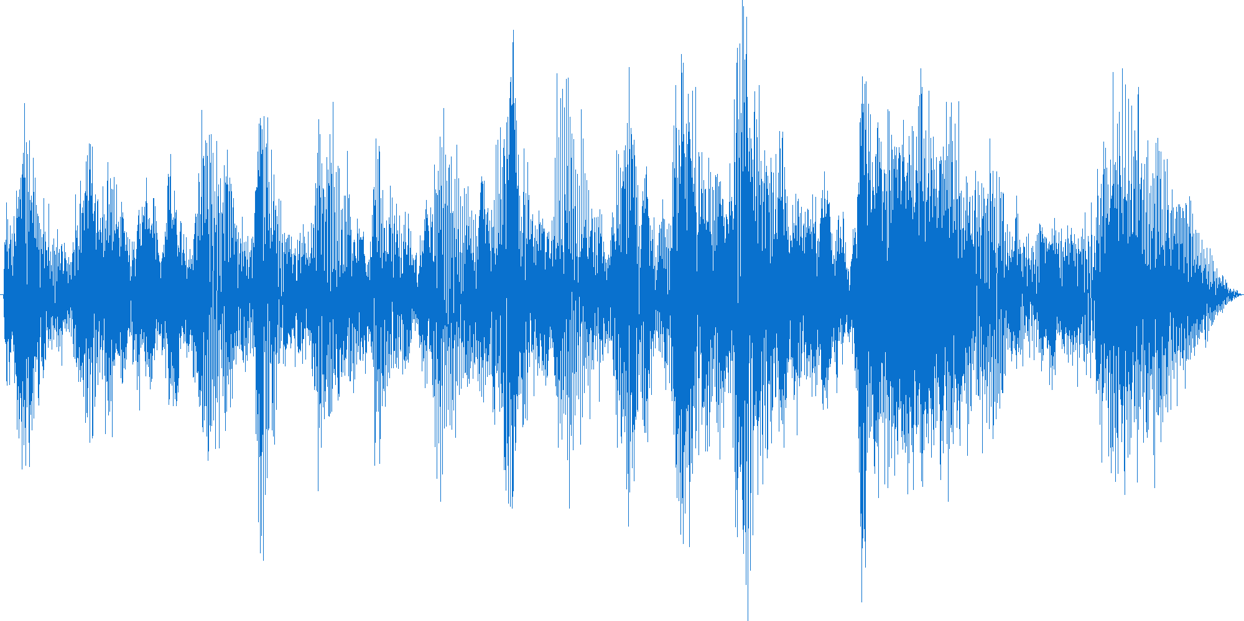
Self-supervised Learning for Speech
“How are you?”
Speech
Recognition
Downstream Model
Speech version of BERT?
unlabeled speech data

Slide 4
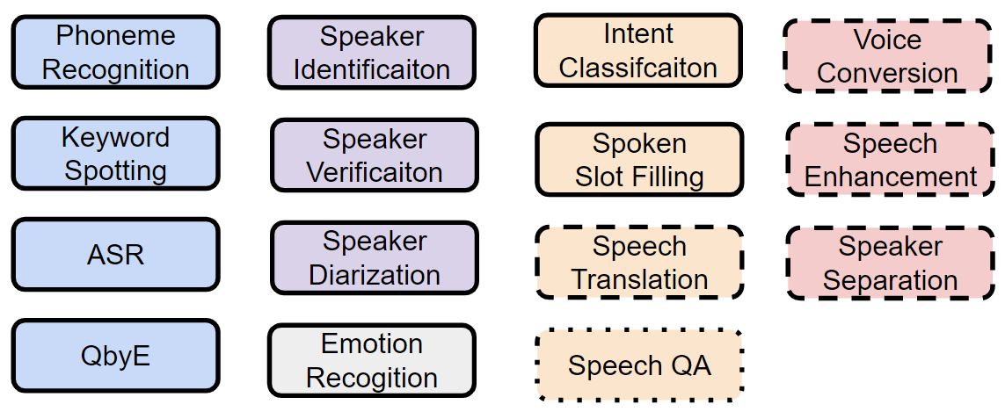
Speech processing Universal PERformance Benchmark (SUPERB)
https://superbbenchmark.org/
Published
at IS 2021
Published
at ACL 2022
Content
Speaker
Paralinguistic
Semantic
Synthesis

Slide 5
Presented at INTERSPEECH 2021
https://arxiv.org/abs/2105.01051
To be appeared at ACL 2022
https://arxiv.org/abs/2203.06849

Slide 6
Speech processing Universal PERformance Benchmark (SUPERB)
To learn more:
Toolkit – S3PRL: https://github.com/s3prl/s3prl
https://youtu.be/MpsVE60iRLM
(Mandarin version)
https://youtu.be/GTjwYzFG54E
(English version)

Slide 7
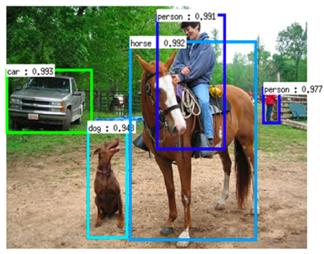
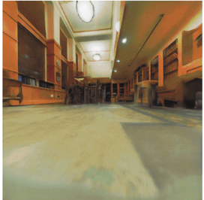
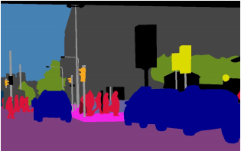
Self-supervised Learning for Image
Image Recognition
Object Detection
Semantic Segmentation
Visual Navigation
How Well Do Self-Supervised Models Transfer?
https://arxiv.org/abs/2011.13377
Scaling and Benchmarking Self-Supervised Visual Representation Learning
https://arxiv.org/abs/1905.01235
Notes:
https://arxiv.org/abs/2111.11398
[16] propose a richer range of downstream benchmarks to evaluate selfsupervised pre-training, but focus on the impact of different pre-training datasets and CNN architectures
https://arxiv.org/pdf/1905.01235.pdf
https://github.com/facebookresearch/fair_self_supervision_benchmark
https://vissl.readthedocs.io/en/v0.1.6/
VISSL toolkit: https://vissl.readthedocs.io/en/v0.1.6/what_is_vissl.html

Slide 8
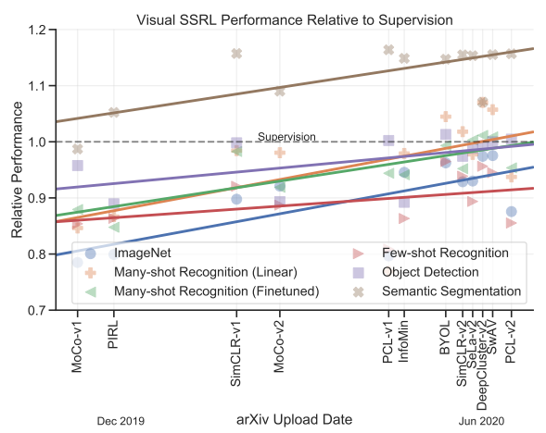
Source of image: https://arxiv.org/abs/2110.09327

Slide 9
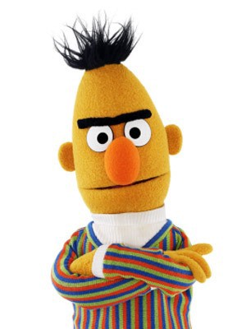
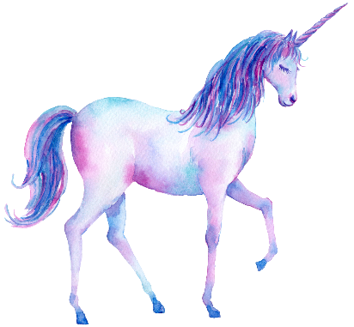
1. Generative Approaches
BERT series
GPT series

Slide 10
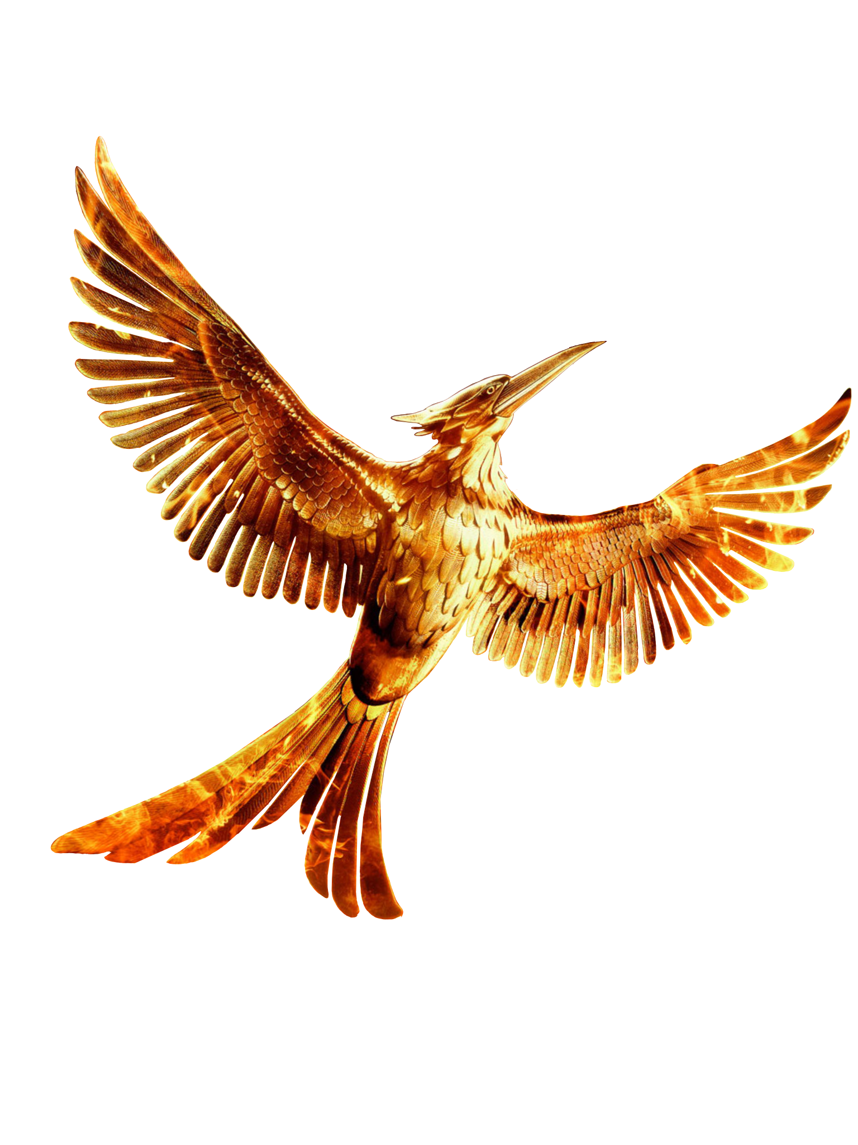
Masking
Learn to reconstruct
Linear
BERT series
Mockingjay
mimic sound it hears
How about speech?
Some of the input are masked
https://arxiv.org/abs/1910.12638
masked
masked

Slide 11
Masking
Masking consecutive features
Smoothness of acoustic features
Masking strategies for speech
https://arxiv.org/abs/1910.12638
Masking specific dimensions
Learn more speaker information in this way
TERA: https://arxiv.org/abs/2007.06028
Notes:
I don’t know why we can get speaker information freq masking.

Slide 12
Predicting Future
$$n=1$$
$$2$$
$$3$$
APC = Autoregressive Predictive Coding
Linear classifier
For text:
$$n=1$$
GPT series
APC
For speech:
How about speech?
Usually $n>3$
https://arxiv.org/abs/1910.12607
Notes:
n = 3 - 5

Slide 13
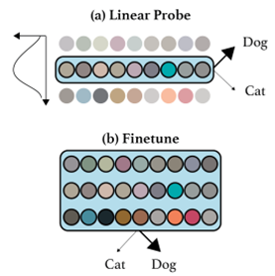
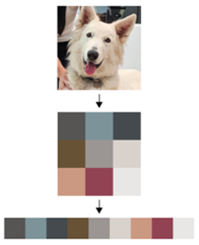
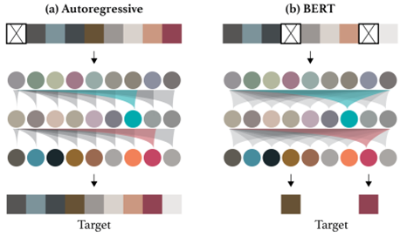
How about image?
https://openai.com/blog/image-gpt/
Notes:
we first resize our image to a lower resolution, which we call the input resolution (IR). O

Slide 14
2. Predictive Approach
Speech and images contain many details that are difficult to generate.
Can a model learn without generation?

Slide 15
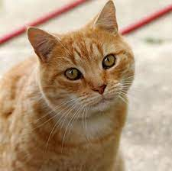
$$0^{°}$$
$${90}^{°}$$
$${180}^{°}$$
$${270}^{°}$$
Encoder
Encoder
Encoder
Encoder
Image - Predicting Rotation
https://arxiv.org/abs/1803.07728
Notes:
(Only name one example)

Slide 16
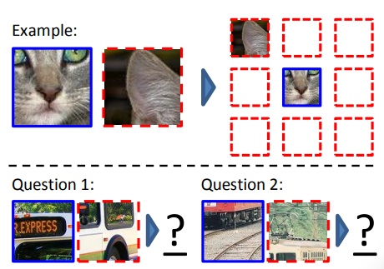
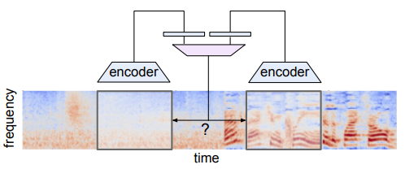
Image – Context Prediction
https://arxiv.org/abs/1505.05192
Similar idea on Speech
https://ieeexplore.ieee.org/document/9060816

Slide 17
Predict Simplified Objects
Speech
HuBERT
https://arxiv.org/abs/2106.07447
BEST-RQ
https://arxiv.org/abs/2202.01855
Image
DeepCluster
https://arxiv.org/abs/1807.05520
7
7
9
9
12
3
3
3
Clustering
Linear
Feature
Extraction

Slide 18
3. Contrastive Learning
Speech and images contain many details that are difficult to generate.
Can a model learn without generation?

Slide 19
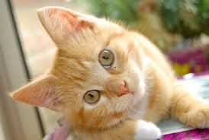
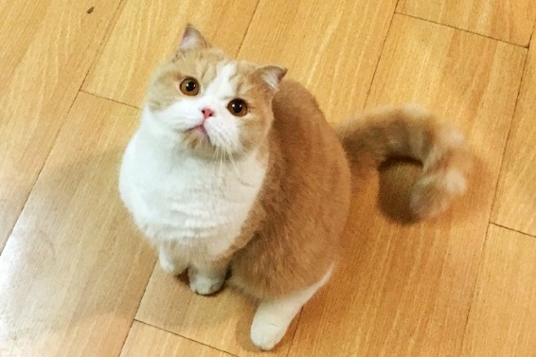
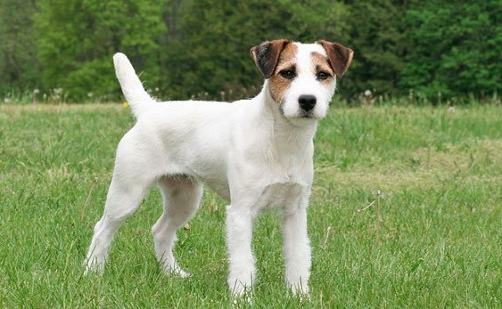
Basic Idea of Contrastive Learning
as close as possible
as far as possible
Encoder
Encoder
Encoder
positive
negative
?
?

Slide 20
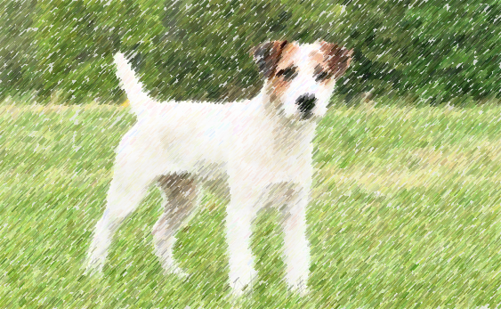
SimCLR
Speech SimCLR: https://arxiv.org/abs/2010.13991
https://arxiv.org/abs/2002.05709
as close as possible
as far as possible
Encoder
Encoder
Encoder
random cropping, color distortions, Gaussian blur, etc.
positive
negative
Data Augmentation
Notes:
apply three simple augmentations: random cropping followed by resize back to the original size, random color distortions, and random Gaussian blur.
===
Negative examples?
Speech SimCLR: random pitch shift, speed perturbation, room reverberation and additive noise to the original waveform. Time masking and frequency masking are also applied to spectrogram.

Slide 21
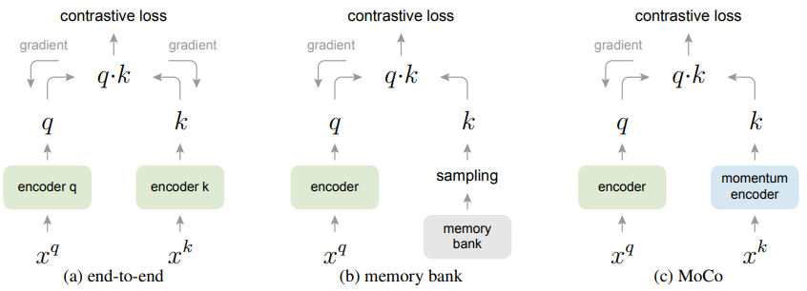
MoCo
https://arxiv.org/abs/1911.05722
MoCo v2
https://arxiv.org/abs/2003.04297

Slide 22
Contrastive Learning for Speech
CPC
https://arxiv.org/abs/1807.03748
Wav2vec
GRU in CPC,
CNN in Wav2vec
https://arxiv.org/abs/1904.05862
Linear
Predicter
positive
negative
Encoder
Encoder
…..

Slide 23
Contrastive Learning for Speech
VQ-wav2vec
https://arxiv.org/abs/1910.05453
How to train with quantization: https://youtu.be/JZvEzb5PV3U
Linear
Predicter
3
9
3
7
11
31
79
21
Encoder
Encoder
…..

Slide 24
Contrastive Learning for Speech
VQ-wav2vec + BERT
3
11
https://arxiv.org/abs/1910.05453
Encoder (BERT architecture)
Discrete BERT
https://arxiv.org/abs/1911.03912
3
9
3
7
11
31
fixed
Encoder (from VQ-wav2vec)
…..

Slide 25
Contrastive Learning for Speech
Wav2vec 2.0
https://arxiv.org/abs/2006.11477
Encoder (BERT architecture)
Continuous input is critical
Quantized target improves performance
3
9
3
7
11
31
Jointly trained
Encoder
Why not formulated as typical classification?
…..
Notes:
102.4k codewords

Slide 26
Alterative way to understand Wav2vec 2.0
天
地
度
天
度
……
……
……
地
Is BERT contrastive learning?
BERT
BERT
深
度
學
習
深
度
學
習

Slide 27
Alterative way to understand Wav2vec 2.0
Classification vs. Contrastive
Classification
Contrastive
last layer output
last layer output
=
Embedding for each class

Slide 28
Alterative way to understand Wav2vec 2.0
天
地
度
……
……
……
Infinite negative examples
Limited numbers of negative examples
BERT
深
度
學
習

Slide 29
Alterative way to understand Wav2vec 2.0
9
7
3
Encoder (BERT architecture)
3
9
3
7
11
Encoder

Slide 30
Alterative way to understand Wav2vec 2.0
9
7
3
Encoder (BERT architecture)
3
9
3
7
11
Encoder

Slide 31
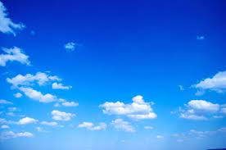
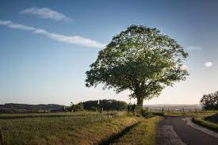
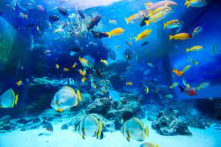
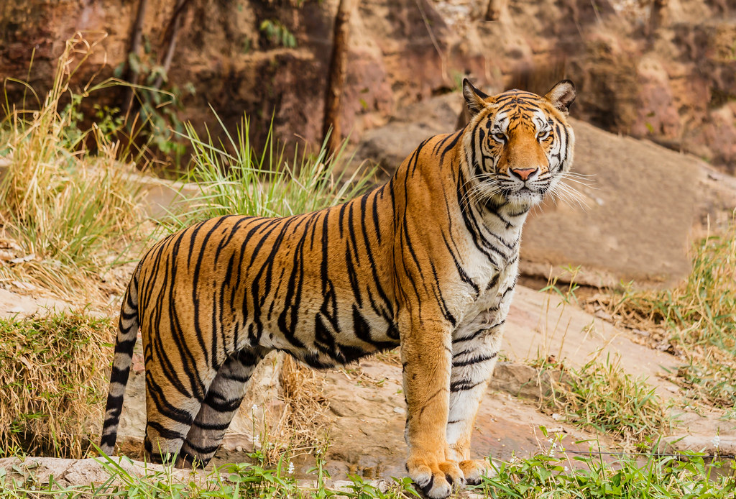
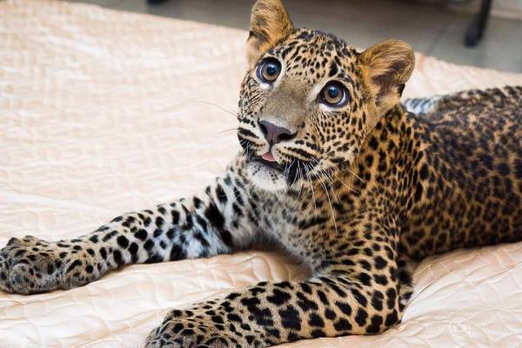
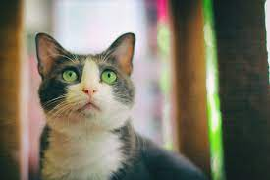
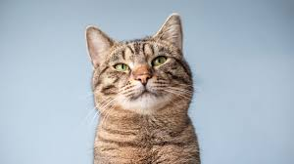
Selecting Negative Examples is not trivial …
But cannot be too hard …
The negative examples should be hard enough.
Notes:
Contrastive Learning with Hard Negative Samples: https://arxiv.org/abs/2010.04592

Slide 32
4. Bootstrapping Approaches
Learning without negative examples
Notes:
Architectural tricks
Train a student network to predict the rep. of teacher network
SimSiam
“BYOL” without the momentum encoder
“SimCLR” without negative pairs
“SwAV” without clustering
SimSiam is related to each method by removing one of its core components.

Slide 33
Bootstrapping Approaches
as close as possible
update
as close as possible
Predictor
update
update
Encoder
Encoder
Encoder
Encoder
Collapse!
Copy
positive
positive

Slide 34
Alterative way to understand Bootstrapping
Typical Knowledge Distillation
as close as possible
as close as possible
Predictor
Teacher
fixed
Student becomes teacher
update
update
fixed
Teacher
Encoder
Student
Encoder
Student

Slide 35
Bootstrapping Approaches
BYOL
Image
Bootstrap your own latent (BYOL)
https://arxiv.org/abs/2006.07733
Simple Siamese (SimSiam)
https://arxiv.org/abs/2011.10566
Speech
Data2vec: the student learns from multiple layers of the teacher
https://arxiv.org/abs/2202.03555
$$θ←λθ+\left(1−λ\right)θ′$$
Moving Average
Teacher
Encoder
$$θ$$
Student
Encoder
$$θ′$$
positive

Slide 36
5. Simply Extra Regularization
Learning without negative examples
Barlow Twins
https://arxiv.org/abs/2103.03230
Variance-Invariance-Covariance Regularization (VICReg)
https://arxiv.org/abs/2105.04906

Slide 37
Audio: DeLoRes
Covariance
https://arxiv.org/abs/2203.13628
Variance
Off-diagonal elements close to 0
Variance lager than a threshold
Prevent collapse
Invariance
as close as possible
Encoder
Encoder
Encoder
Encoder
Encoder
positive
Notes:
Recall PCA: https://youtu.be/iwh5o_M4BNU
batch size 128, 256 and 512?
If X and Y are independent variables, then their covariance is 0
a covariance is zero for two independent random variables. However, a zero covariance does not imply that two random variables are independent.

Slide 38
Concluding Remarks
 | Image | Speech / Audio
Generative | GPT for image | Mockingjay, APC
Predictive | Rotation Prediction, etc. | HuBERT
Contrastive | SimCLR, MoCo | CPC, Wav2vec series
Bootstrapping | BYOL, SimSiam | Data2vec
Regularization | Barlow Twins, VICReg | DeLoRes
Notes:
Draw a table

